Slide 1

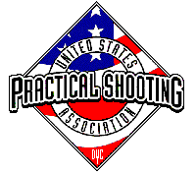
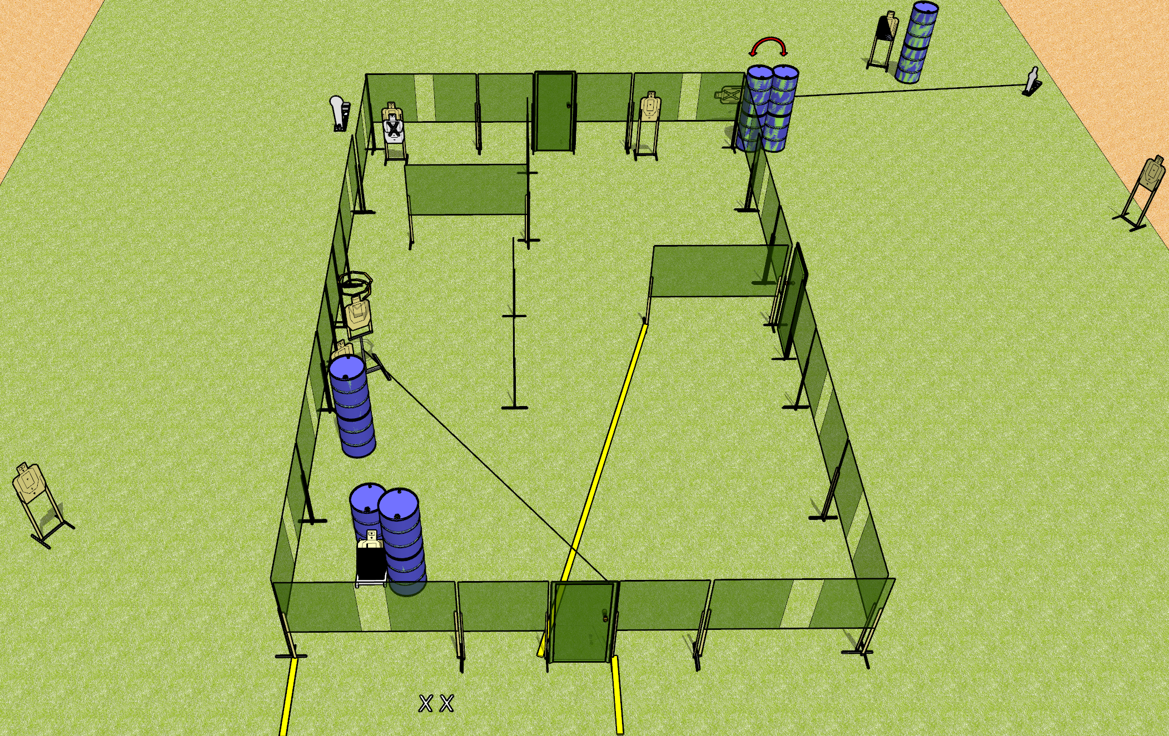
 | Dothan Gun Club – USPSA Match It’s Okay to Shoot These Walls Billy Course Designer : Drew Coleman
Round Count 20 rounds 9 paper 1 colt popper, 1 mini popper
Equipment List 1 action target, 1 diagonal Drop turner + activator Swinger + activator

Slide 2
It’s Okay to Shoot These Walls Billy
Written Stage Briefing
It’s Okay to Shoot These Walls Billy is a 20 round, 100 point, Comstock course of fire. There are 9 USPSA targets, 1 colt popper, and 1 mini popper. The best 2 hits on paper will score, and steel must fall to score. The start signal is audible.
All doors must be shut prior to the start signal. (Drew remembered to write that this time)
The drop turner is activated by the stomp box, and is a disappearing target. The swinger is activated by the mini popper, and is visible at rest.
Handgun start position is both feet on X’s, wrists below belt, handgun loaded and holstered.
PCC start position is both feet on X’s, stock on belt. Loaded carbine is held with both hands, safety on.
On start signal, engage targets as they become available from within the shooting area.

Slide 3
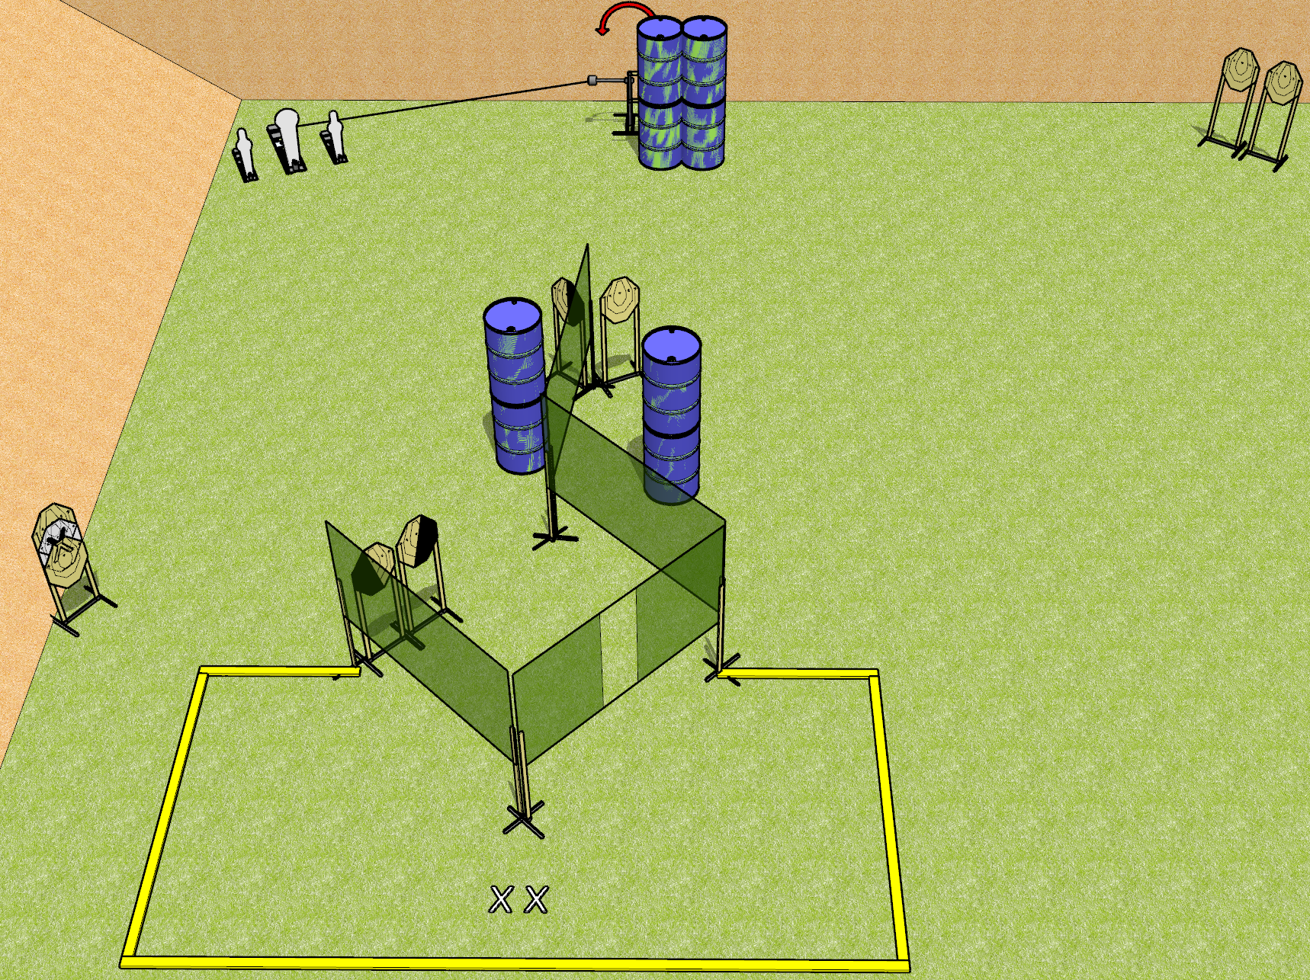
 | Dothan Gun Club – USPSA Match Watch This Course Designer : Drew Coleman
Round Count 21 rounds 9 IPSC 2 minis, 1 colt
Equipment List 6 wall feet 2 medium fault lines 2 diagonal, 1 right HC (down the middle) 1 swinger + activator

Slide 4
Watch This
Written Stage Briefing
Watch This is a 21 round, 110 point, Comstock course of fire. There are 9 ISPC targets, 2 mini poppers, and 1 colt popper. The best 2 hits on paper will score, and steel must fall to score. The start signal is audible.
The swinger is activated by the colt popper, and remains visible at rest.
Handgun start position is both feet on X’s, wrists below belt. Handgun is loaded and holstered.
PCC start position is both feet on X’s, stock on belt. Loaded carbine is held with both hands, stock on belt, safety on.
On start signal, engage targets as they become available from within the shooting area.

Slide 5
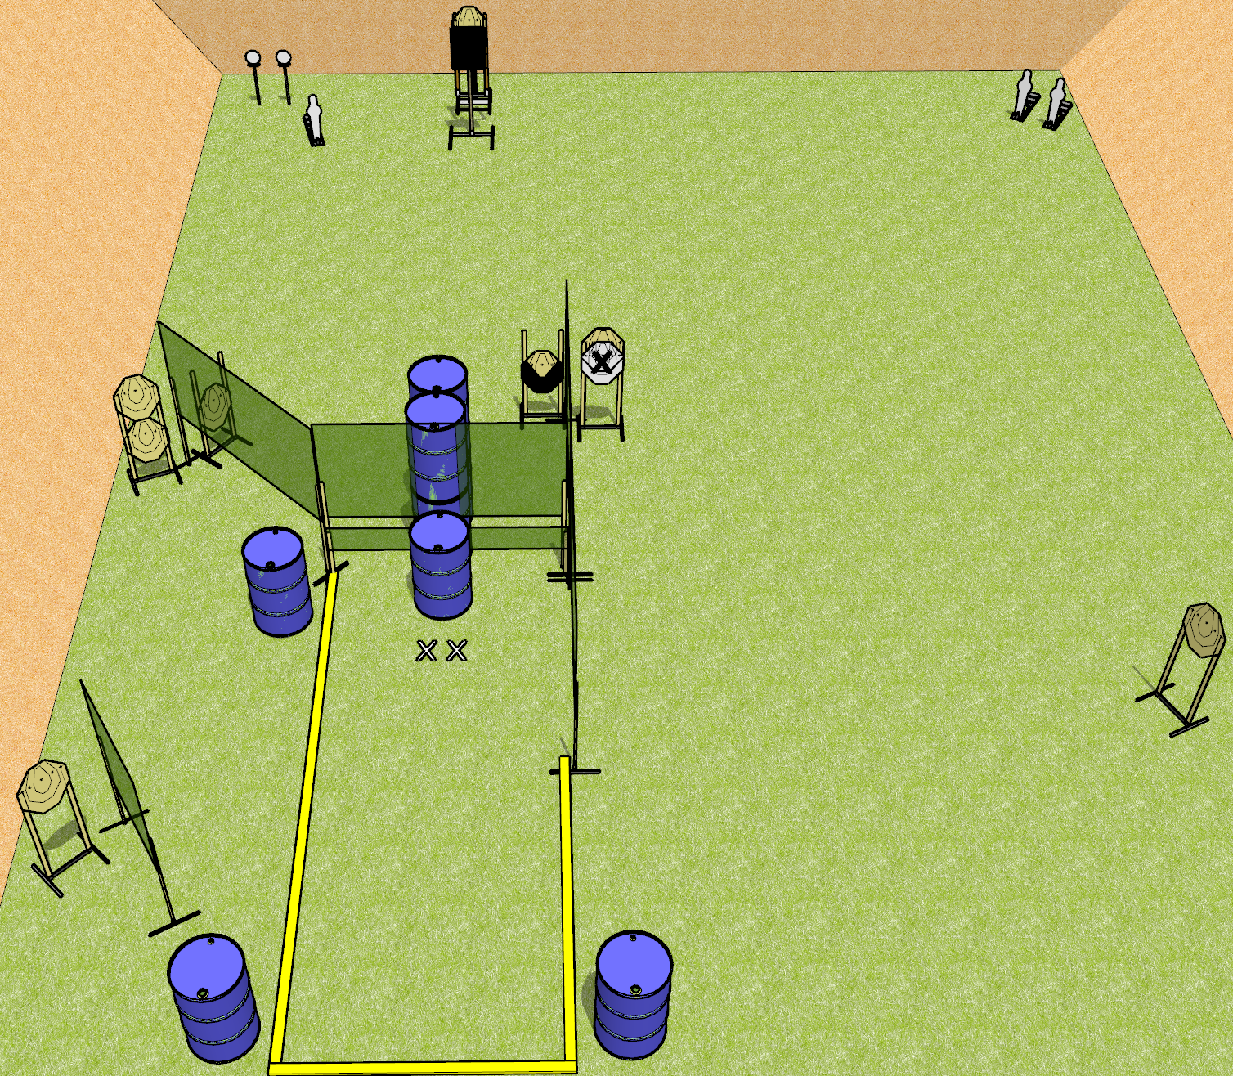
 | Dothan Gun Club – USPSA Match This Will Only Take a Moment Course Designer : Drew Coleman
Round Count 29 rounds 8 IPSC 3 minis, 2 plates
Equipment List 9 wall feet The tall port wall and the low wall to go with it Bobber + activator + steel challenge plate

Slide 6
This Will Only Take a Moment
Written Stage Briefing
This Will Only Take a Moment is a 29 round, 145 point, Comstock course of fire. There are 8 IPSC targets, 3 mini poppers, and 2 falling plates. The best 3 hits on paper will score, and steel must fall to score. The start signal is audible.
The bobber is activated by the leftmost mini popper, and remains visible at rest. It must be activated before being engaged.
Rule 8.2.3/8.2.3.1 – you may not touch a firearm or magazine after standby and before the start signal.
Start position is both feet on X’s, palms flat on barrel. Firearm is unloaded on any barrel. All magazines to be used on stage are on any other barrels. No magazines may be on the same barrel as the firearm.
On start signal, engage targets as they become available from within the shooting area.

Slide 7
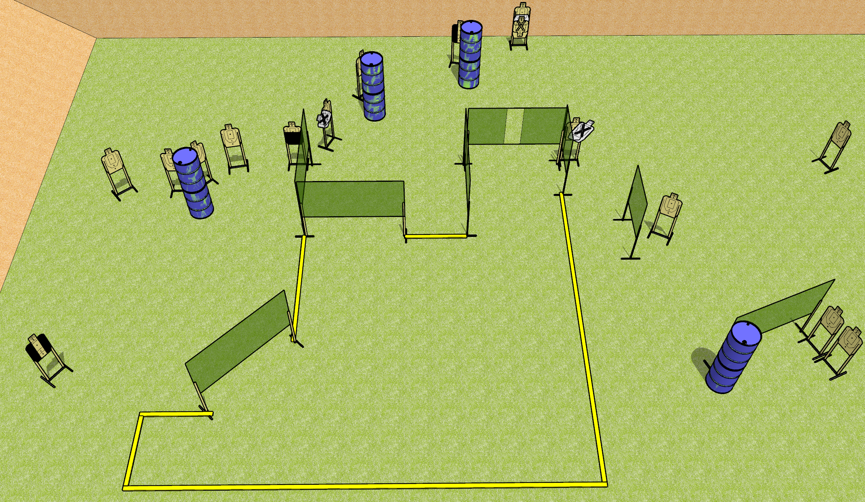
 | Dothan Gun Club – USPSA Match Hating on Jamie Course Designer : Drew Coleman
Round Count 32 rounds 16 USPSA
Equipment List 13 wall feet 3 medium fault lines 2 tuxedos, 1 50%

Slide 8
Hating on Jamie
Written Stage Briefing
Hating on Jamie is a 32 round, 160 point, Comstock course of fire. There are 16 USPSA targets. The best 2 hits on paper will score, and steel must fall to score. The start signal is audible.
Handgun start position is anywhere inside the shooting area. Handgun is loaded and holstered.
PCC start position is muzzle anywhere inside the shooting area, stock on belt. Carbine is loaded with safety on.
On start signal, engage targets as they become available from within the shooting area.

